Slide 1
Game Nexys System on Chip Final Project
By Oliver Jarvis

Slide 2
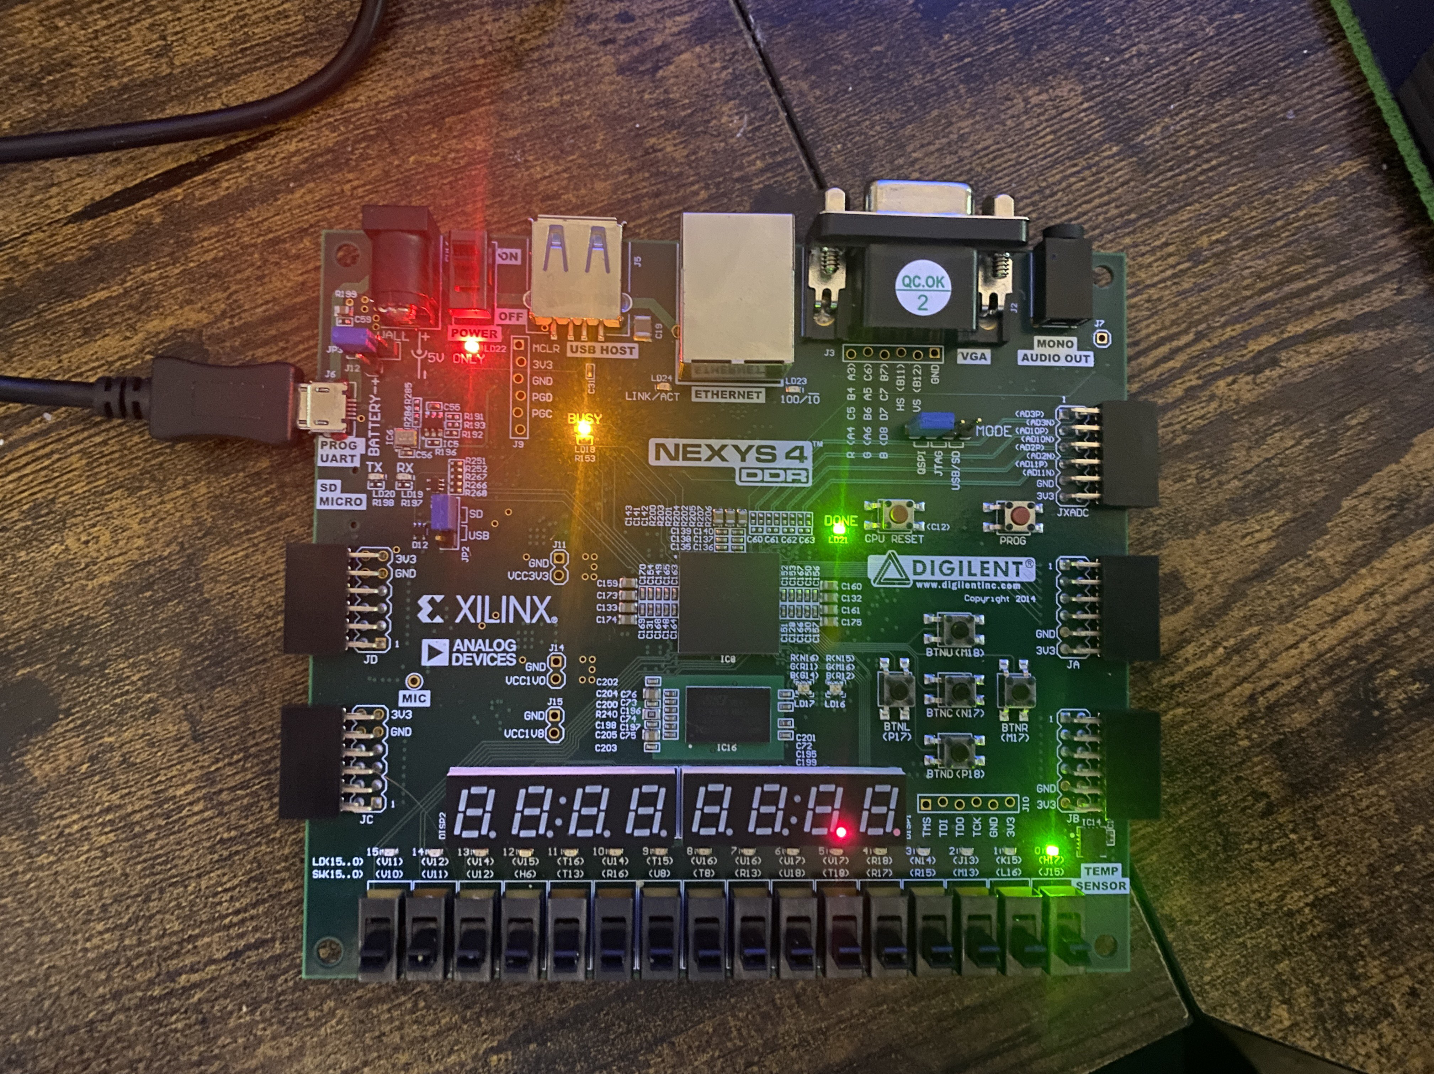
Home Menu
Btn_c enters game
Btn_u select game with SW[4:0]
LED[4:0] light up to respective game
UART prints game selected

Slide 3
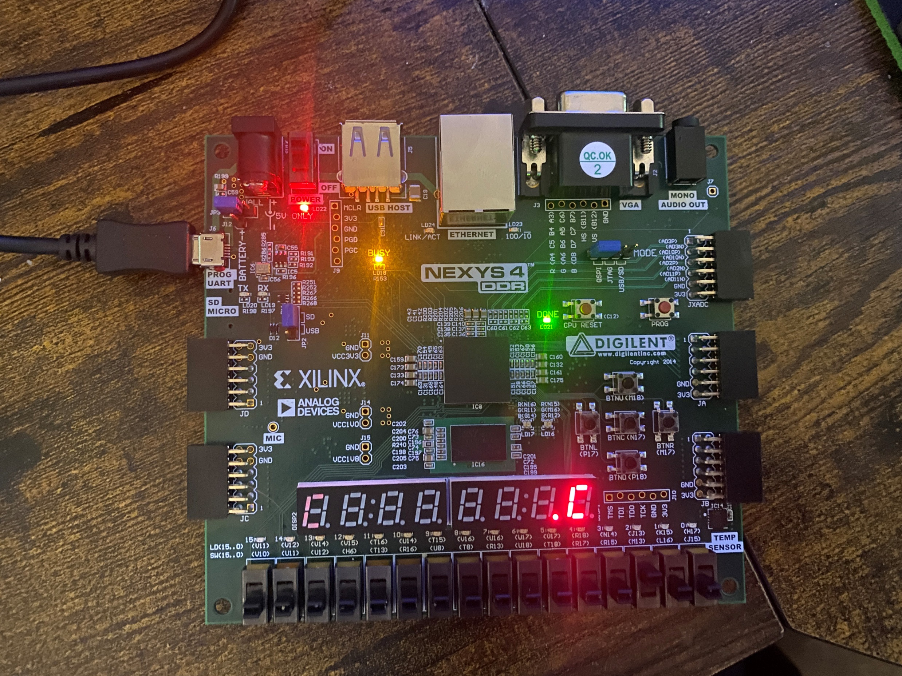
Game Buttons
Press the buttons in random order given
Wrong buttons and slower times subtract score
SPI accelerometer randomizer

Slide 4
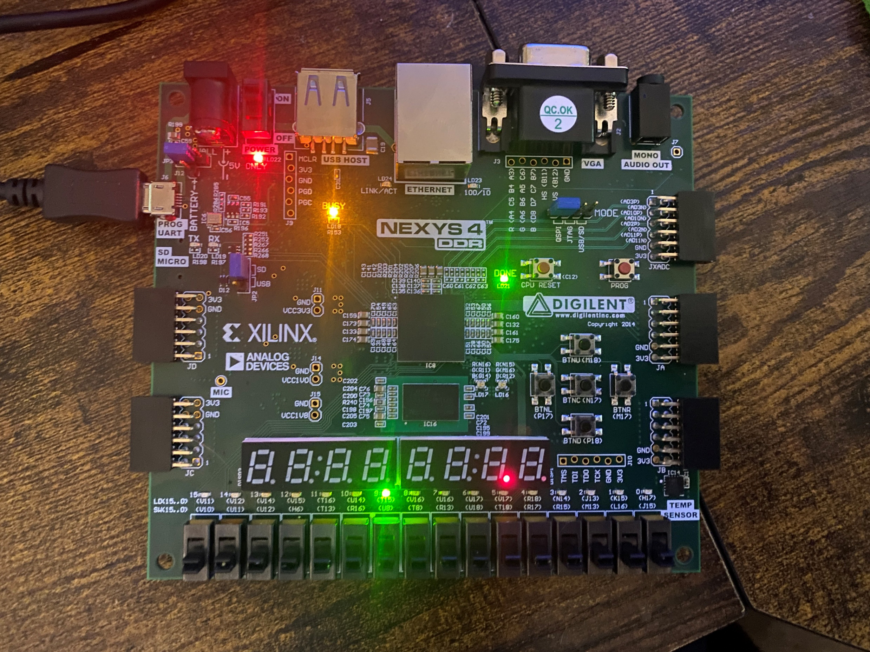
Game Switches
Random switches light up or turn off
Flick switches up/down within 1.5s
SPI accelerometer randomizer

Slide 5


Game Buttons_Switches
Combination of buttons and switches.
Hold down given button or flick up/down switch when prompted
SPI accelerometer randomizer

Slide 6
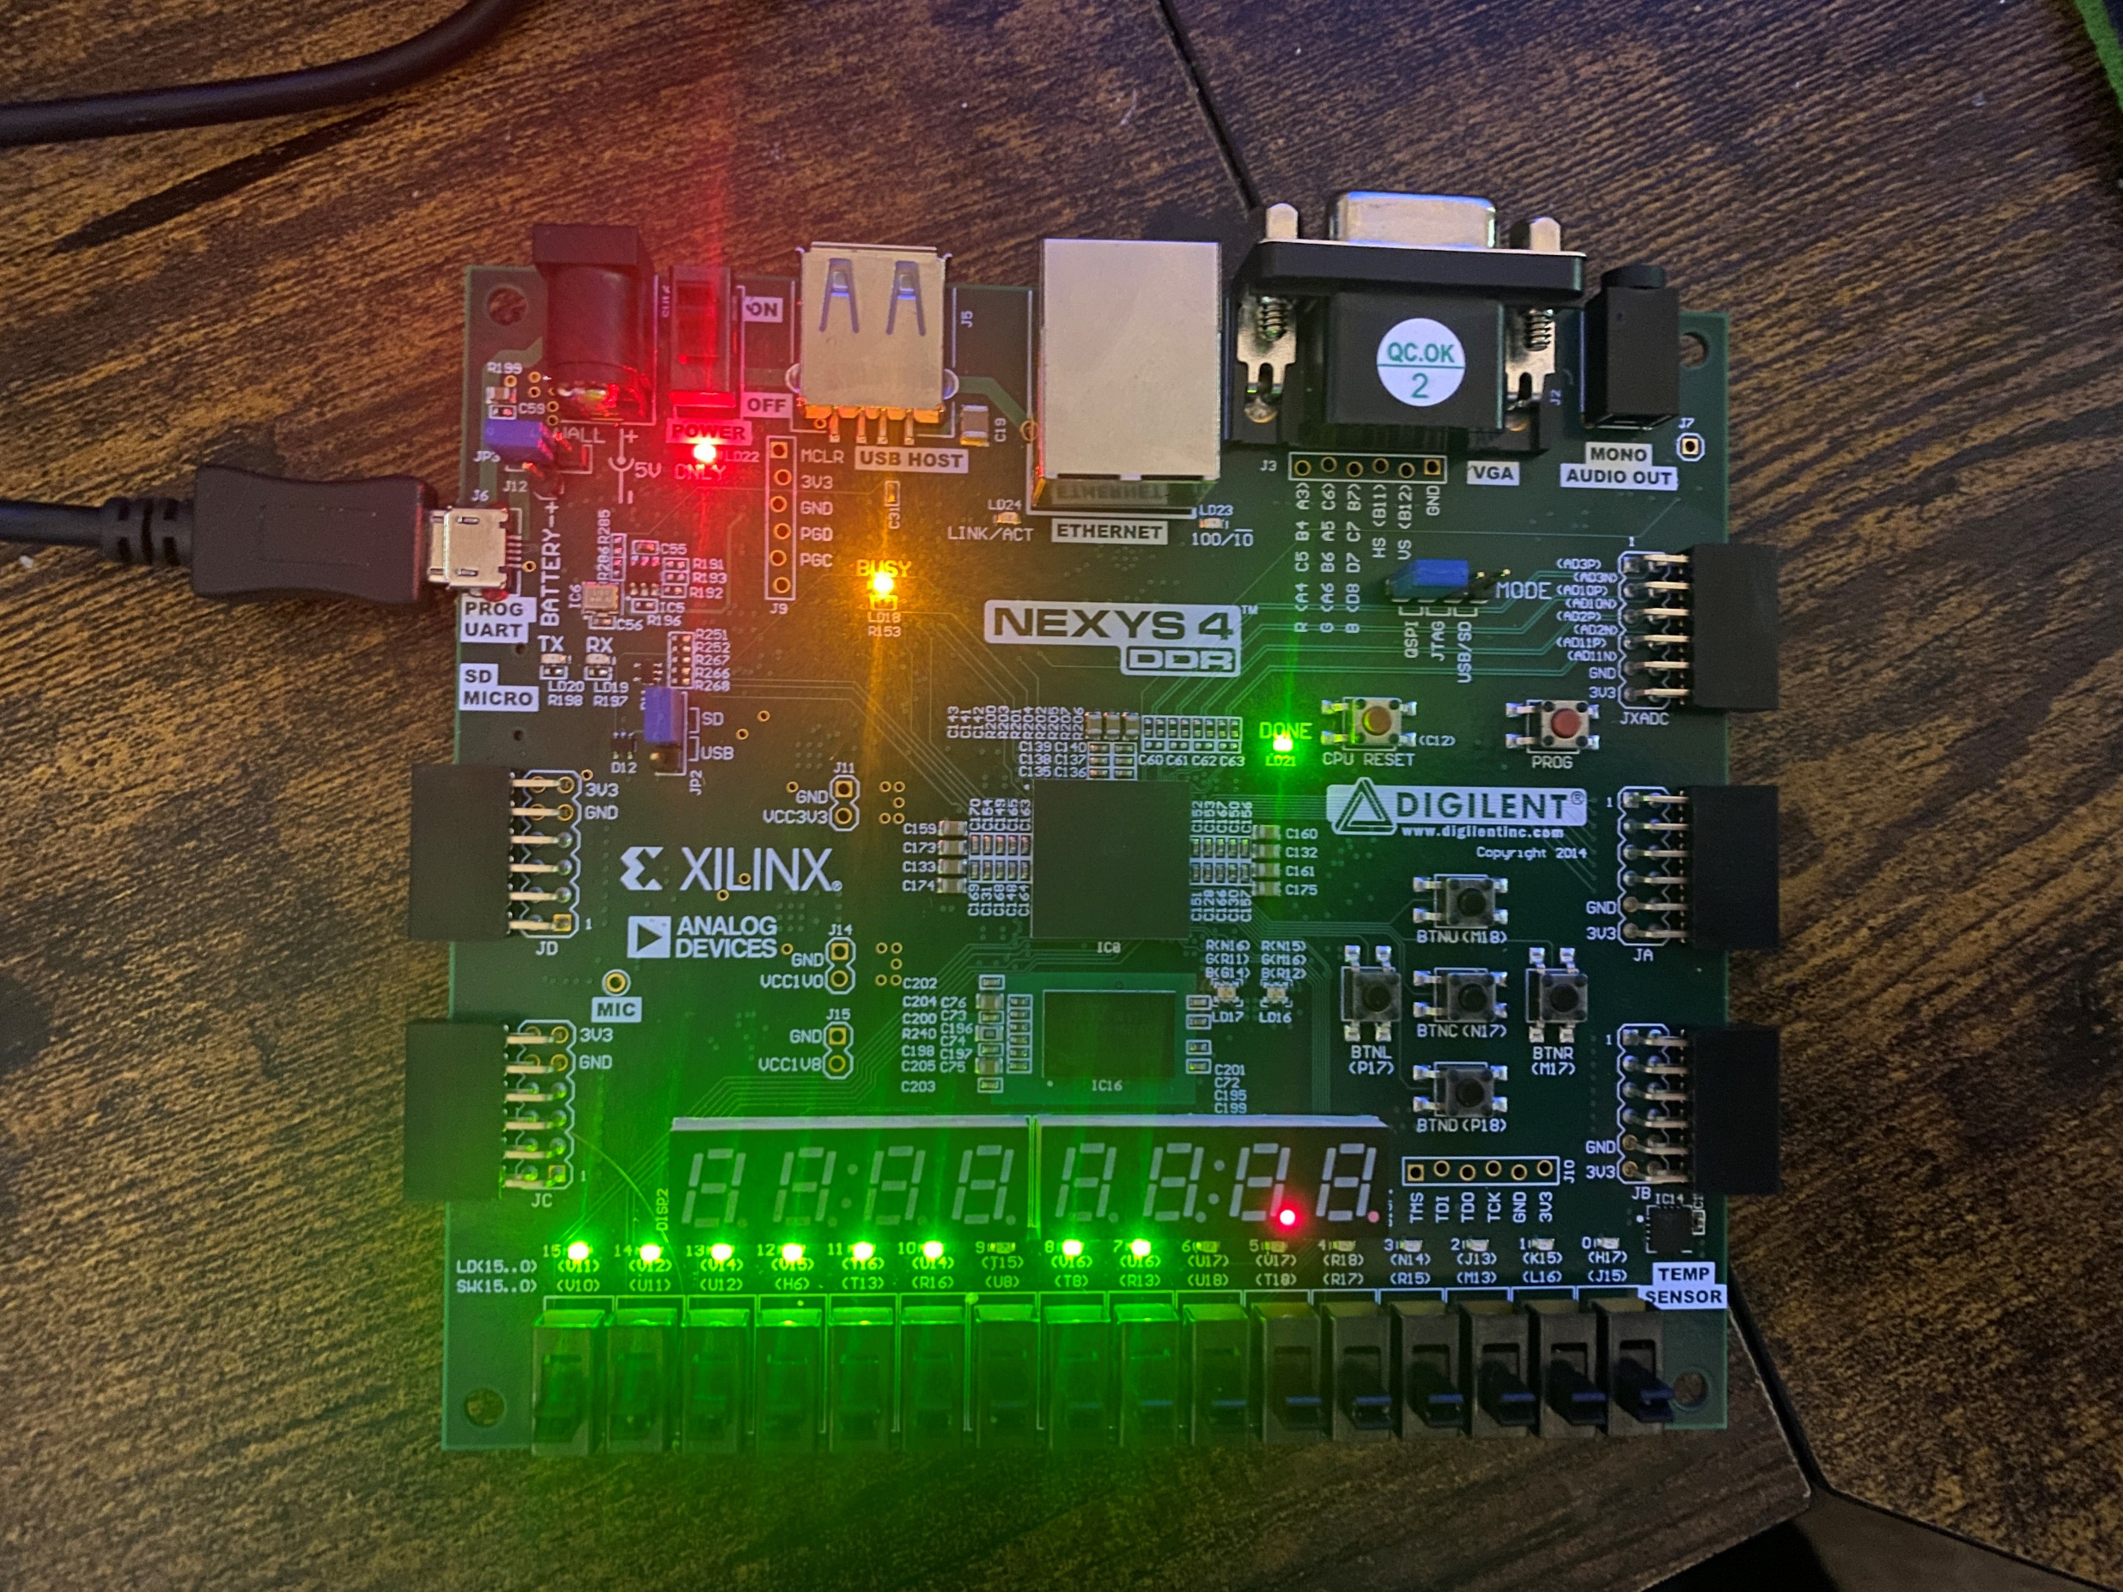
Game Memory
Memorize LEDS and use Switches to turn respective LEDs on
Wrong switch up/down and you lose
SPI accelerometer randomizer

Slide 7
Game Wordle
Use centre button to start and submit answer
Type 5 letter word, if letter is correct, respective LED[4:0] turns on corresponding to letter placement. If letter is in word, LED flashes on/off.
SPI accelerometer randomizer

